Slide 1
Vivekanand Education Society’s Institute of Technology
Department of IT
AIDS-2
BE-SEM VII

Slide 2

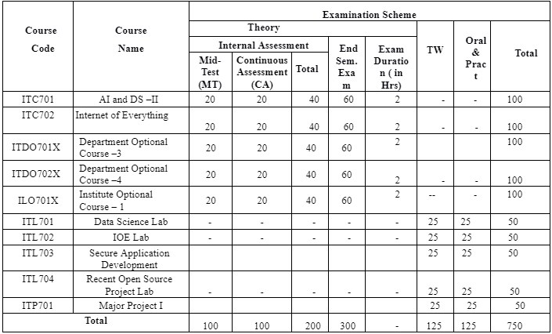
Schema of the Proposed revised syllabus at BE (SEM VII)
Department of Information Technology, BOS meeting 03-07-2023

Slide 3
The Proposed revised syllabus at BE (SEM VII)
Subject Code | Name of subject | Status | Link
ITDO7022 | DLOC 4:AR – VR | Modified the contents by 10-15% | IT_BE_SemVII_DLOC_ARVR
ITDO7023 | DLOC 4:Quantum Computing | Adopted the contents as it is from the syllabus of UoM | IT_BE_SemVII_Quantum Computing
ITDO7024 | DLOC 4:Information Retrieval System | Modified the contents by 10-15% | IT_BE_ SemVII_ DLOC_IR
ILO7011 | ILOC1: Product Lifecycle Management | Adopted the contents as it is from the syllabus of UoM | IT_BE_SemVII_ILOC1_PLM
ILO7013 | ILOC1:Management Information System | Modified the contents by 10-15% | IT_BE_SemVII_ILOC_MIS
ILO7016 | ILOC1:Cyber Security and Laws | Adopted the contents as it is from the syllabus of UoM | IT_BE_SemVII_ILOC1_CSL
ITL701 | Data Science Lab | Modified the contents by 10-15% | BE SEM VII AI &DA II
Department of Information Technology, BOS meeting 03-07-2023

Slide 4
The Proposed revised syllabus at BE (SEM VII)
Subject Code | Name of subject | Status | Link
ITC701 | AI and DS –II | Modified the contents by 10-15% | IT_BE SemVII_ AI &DS- II
ITC702 | Internet of Everything |  | IT_BE_SemVII_IOE_Lab
ITDO7011 | DLOC 3: Storage Area Network | Adopted the contents as it is from the syllabus of UoM | IT_BE_SemVII_DLOC3_SAN
ITDO7012 | DLOC 3:High Performance computing |  | IT_BE_SemVII_DLOC3_HPC
ITDO7013 | DLOC 3:Infrastructure Security | Modified the contents by 10-15% | IT_BE_SemVII_DLOC3_IS
ITDO7014 | DLOC 3:Software Testing and QA |  | IT_BE_SemVII_DLOC3_STQA
ITDO7021 | DLOC 4:MANET | Adopted the contents as it is from the syllabus of UoM | MANET_SYLLABUS
Department of Information Technology, BOS meeting 03-07-2023

Slide 5
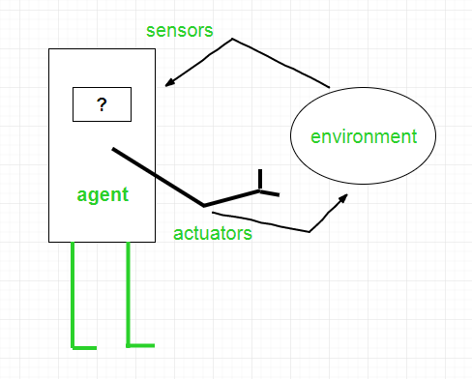
Agent in AI
Agent in AI :- an agent is a computer program or system that is designed to perceive its environment, make decisions and take actions to achieve a specific goal or set of goals

Slide 6
Structure of an AI Agent :-
AI Agent = Architecture + Agent Program
Architecture is the machinery that the agent executes on. It is a device with sensors and actuators, for example, a robotic car, a camera, and a PC.
An agent program is an implementation of an agent function. An agent function is a map from the percept sequence(history of all that an agent has perceived to date) to an action.

Slide 7
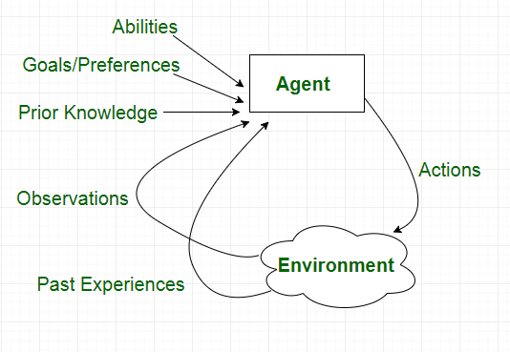
Characteristics of Agent :-

Slide 8
Search Techniques/Search Algorithm
Search algorithms are one of the most important areas of Artificial Intelligence.

Slide 9
Search Algorithm Terminologies:
Search: Searchingis a step by step procedure to solve a search-problem in a given search space. A search problem can have three main factors:
Search Space: Search space represents a set of possible solutions, which a system may have.
Start State: It is a state from where agent begins the search.
Goal test: It is a function which observe the current state and returns whether the goal state is achieved or not.
Search tree: A tree representation of search problem is called Search tree. The root of the search tree is the root node which is corresponding to the initial state.
Actions: It gives the description of all the available actions to the agent.
Transition model: A description of what each action do, can be represented as a transition model.
Path Cost: It is a function which assigns a numeric cost to each path.
Solution: It is an action sequence which leads from the start node to the goal node.
Optimal Solution: If a solution has the lowest cost among all solutions.

Slide 10
Properties of Search Algorithms:
1> Completeness: A search algorithm is said to be complete if it guarantees to return a solution if at least any solution exists for any random input.
2> Optimality: If a solution found for an algorithm is guaranteed to be the best solution (lowest path cost) among all other solutions, then such a solution for is said to be an optimal solution.
3> Time Complexity: Time complexity is a measure of time for an algorithm to complete its task.
4>Space Complexity: It is the maximum storage space required at any point during the search, as the complexity of the problem

Slide 11
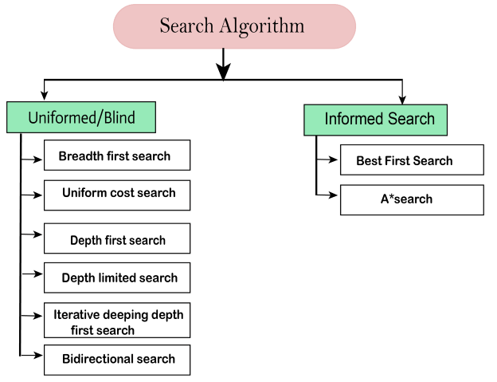
Types of search algorithms
Based on the search problems we can classify the search algorithms into uninformed (Blind search) search and informed search (Heuristic search) algorithms.

Slide 12
Uninformed/Blind Search
Uninformed/Blind Search:-
1)The uninformed search does not contain any domain knowledge
2) It operates in a brute-force way
It can be divided into five main types:
Breadth-first search
Uniform cost search
Depth-first search
Iterative deepening depth-first search
Bidirectional Search

Slide 13
Informed Search
Informed Search
Informed search algorithms use domain knowledge
In an informed search, problem information is available which can guide the search.
Informed search strategies can find a solution more efficiently than an uninformed search strategy
An example of informed search algorithms is a traveling salesman problem.
Greedy Search
A* Search

Slide 14



Uncertainty in AI….????

Slide 15
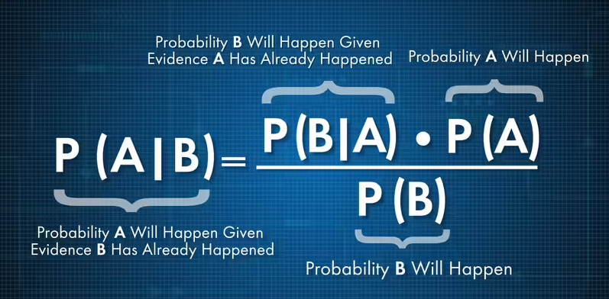
Bayes Theorem :- describes the probability of an event, based on prior knowledge of conditions ...

Slide 16
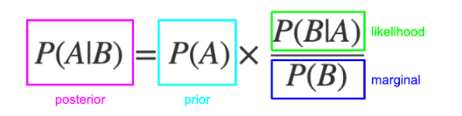
Bayes Theorem

Slide 17
Bayesian network
"A Bayesian network is a probabilistic graphical model which represents a set of variables and their conditional dependencies using a directed acyclic graph."
It is also called a Bayes network, belief network, decision network, or Bayesian model
Bayesian networks are probabilistic, because these networks are built from a probability distribution, and also use probability theory for prediction and anomaly detection.
Bayesian Network can be used for building models from data and experts opinions.
it consists of two parts:
Directed Acyclic Graph
Table of conditional probabilities.

Slide 18
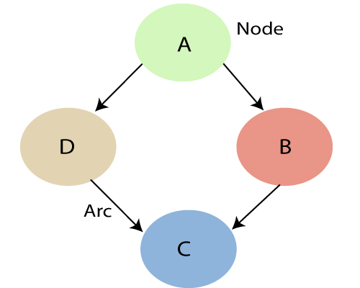
Bayesian network
Each node corresponds to the random variables
Arc or directed arrows represent the causal relationship or conditional probabilities between random variable

Slide 19
Bayesian network
Example: Harry installed a new burglar alarm at his home to detect burglary. The alarm reliably responds at detecting a burglary but also responds for minor earthquakes. Harry has two neighbors David and Sophia, who have taken a responsibility to inform Harry at work when they hear the alarm. David always calls Harry when he hears the alarm, but sometimes he got confused with the phone ringing and calls at that time too. On the other hand, Sophia likes to listen to high music, so sometimes she misses to hear the alarm. Here we would like to compute the probability of Burglary Alarm
Problem:
Calculate the probability that alarm has sounded, but there is neither a burglary, nor an earthquake occurred, and David and Sophia both called the Harry.

Slide 20
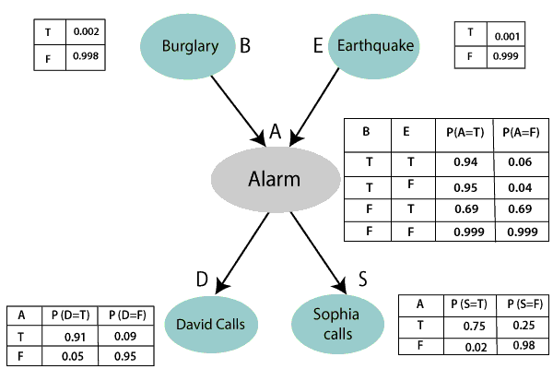
Bayesian network

Slide 21
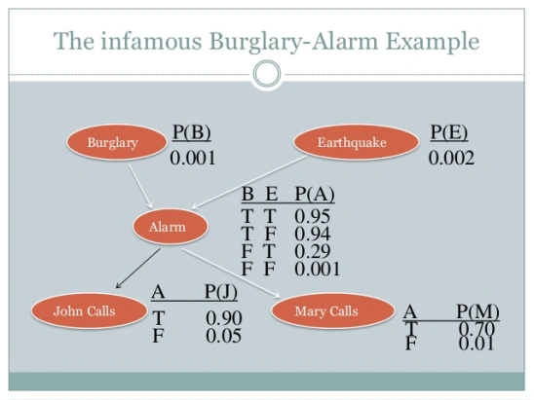
Bayesian network

Slide 22
Bayesian network
Joint probability distribution:
If we have variables x1, x2, x3,....., xn, then the probabilities of a different combination of x1, x2, x3.. xn, are known as Joint probability distribution.
P[x₁, x₂, x₃,....., x_{n}], it can be written as the following way in terms of the joint probability distribution.
= P[x₁| x₂, x₃,....., x_{n}]P[x₂, x₃,....., x_{n}]
= P[x₁| x₂, x₃,....., x_{n}]P[x₂|x₃,....., x_{n}]....P[x_{n-1}|x_{n}]P[x_{n}].

Slide 23
Bayesian network
P[D, S, A, B, E], can rewrite the above probability statement using joint probability distribution:
P[D, S, A, B, E]= P[D | S, A, B, E]. P[S, A, B, E]
=P[D | S, A, B, E]. P[S | A, B, E]. P[A, B, E]
= P [D| A]. P [ S| A, B, E]. P[ A, B, E]
= P[D | A]. P[ S | A]. P[A| B, E]. P[B, E]
= P[D | A ]. P[S | A]. P[A| B, E]. P[B |E]. P[E]

Slide 24
Bayesian network
From the formula of joint distribution, we can write the problem statement in the form of probability distribution:
P(S, D, A, ¬B, ¬E) = P (S|A) *P (D|A)*P (A|¬B ^ ¬E) *P (¬B) *P (¬E).
= 0.75* 0.91* 0.001* 0.998*0.999
= 0.00068045.
Hence, a Bayesian network can answer any query about the domain by using Joint distribution.

Slide 25
Decision Theory
“ Decision theory is the study of principles and algorithms for making correct decisions “
Decisions that allow an agent to achieve better outcomes with respect to its goals. Every action at least implicitly represents a decision under uncertainty: in a state of partial knowledge, something has to be done, even if that something turns out to be nothing (call it "the null action"). Even if you don't know how you make decisions, decisions do get made, and so there has to be some underlying mechanism.
What is it? And how can it be done better? Decision theory has the answers.

Slide 26
Markov Decision Process
“A Markov decision process (MDP) refers to a stochastic decision-making process that uses a mathematical framework to model the decision-making of a dynamic system. “

Slide 27
How does a Markov Decision Process work ?
The MDP model operates by using key elements such as the agent, states, actions, rewards, and optimal policies. The agent refers to a system responsible for making decisions and performing actions. It operates in an environment that details the various states that the agent is in while it transitions from one state to another. MDP defines the mechanism of how certain states and an agent’s actions lead to the other states. Moreover, the agent receives rewards depending on the action it performs and the state it attains (current state).
The MDP framework has the following key components:
S: states (s ∈ S)
A: Actions (a ∈ A)
P (St+1|st.at): Transition probabilities
R (s): Reward

Slide 28
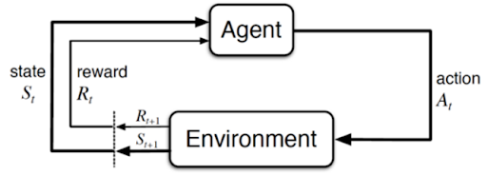
Markov Decision Process
The graphical representation of the MDP model is as follows:

Slide 29
Markov Decision Process
The MDP model uses the Markov Property, which states that the future can be determined only from the present state that encapsulates all the necessary information from the past. The Markov Property can be evaluated by using this equation:
P[St+1|St] = P[St+1 |S1,S2,S3……St]
According to this equation, the probability of the next state (P[St+1]) given the present state (St) is given by the next state’s probability (P[St+1]) considering all the previous states (S1,S2,S3……St).

Slide 30
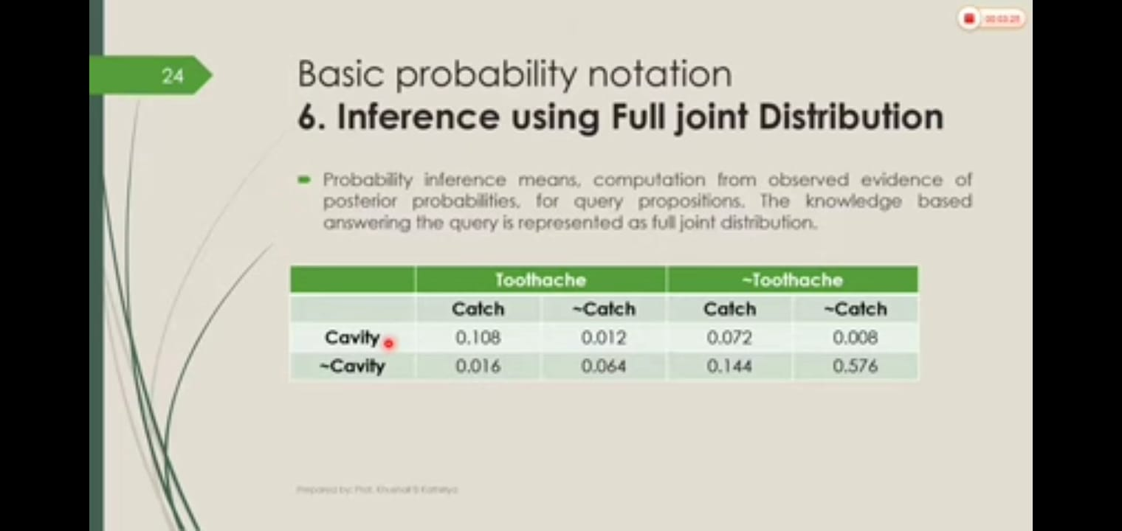
Inference using Full joint distribution

Slide 31
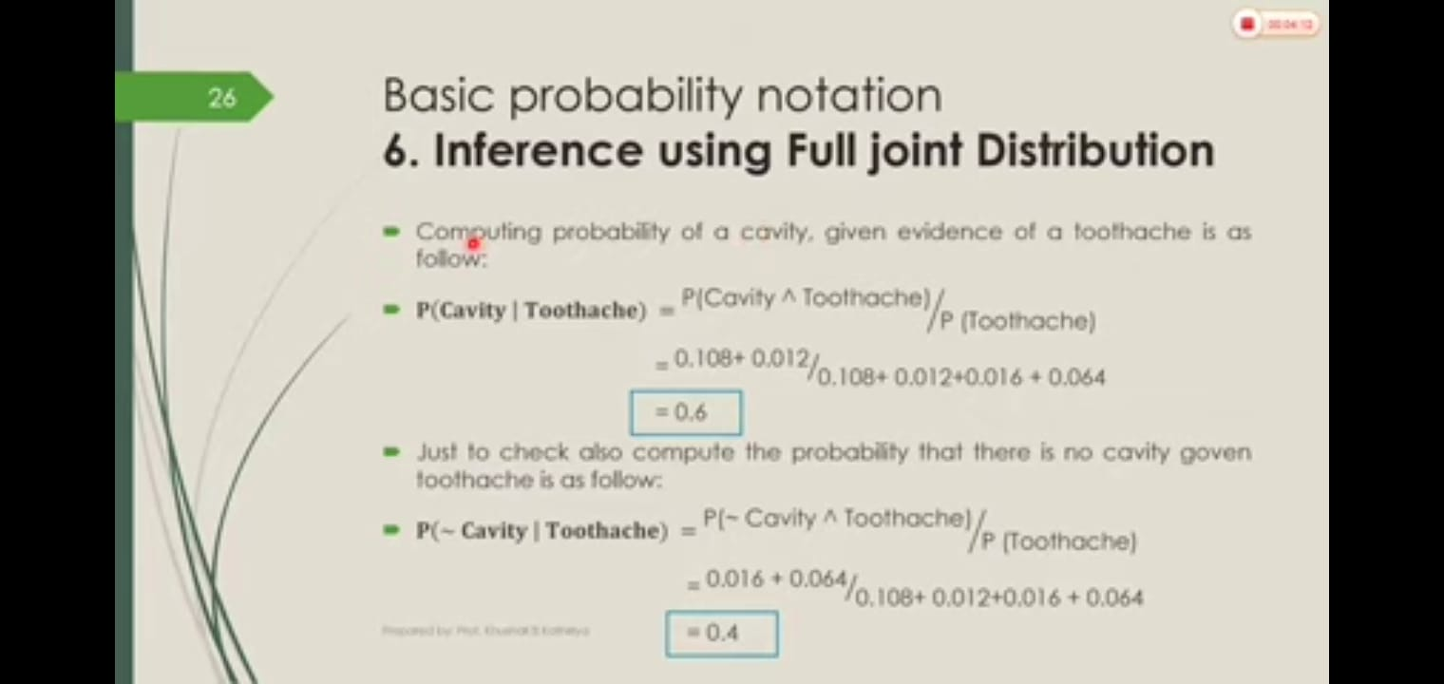
Inference using Full joint distribution

Slide 32
Fuzzy Logic ?????

Slide 33
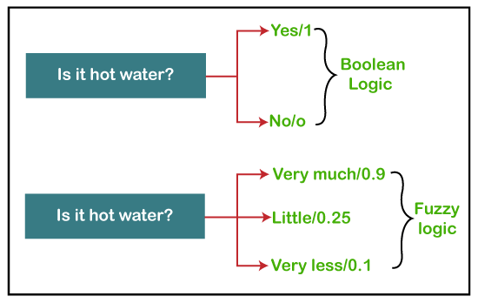
Fuzzy Logic

Slide 34
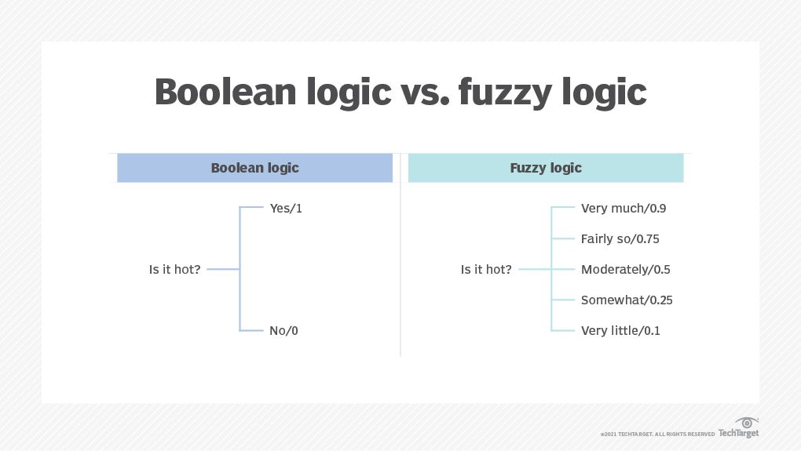
Fuzzy Logic

Slide 35
Fuzzy Logic
Fuzzy Logic Systems (FLS) produce acceptable but definite output in response to incomplete, ambiguous, distorted, or inaccurate (fuzzy) input
Fuzzy Logic (FL) is a method of reasoning that resembles human reasoning. The approach of FL imitates the way of decision making in humans that involves all intermediate possibilities between digital values YES and NO.
CERTAINLY YES
POSSIBLY YES
CANNOT SAY
POSSIBLY NO
CERTAINLY NO

Slide 36
Fuzzy Logic Systems Architecture
It has four main parts as shown −
1> Fuzzification Module − It transforms the system inputs, which are crisp numbers, into fuzzy sets. It splits the input signal into five steps such as −
CERTAINLY YES
POSSIBLY YES
CANNOT SAY
POSSIBLY NO
CERTAINLY NO

Slide 37
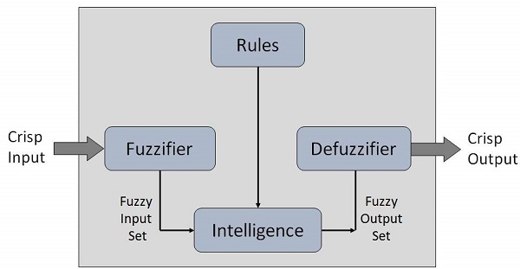
Structure of Fuzzy System
2> Knowledge Base − It stores IF-THEN rules provided by experts.
3> Inference Engine − It simulates the human reasoning process by making fuzzy inference on the inputs and IF-THEN rules.
4> Defuzzification Module − It transforms the fuzzy set obtained by the inference engine into a crisp value.

Slide 38
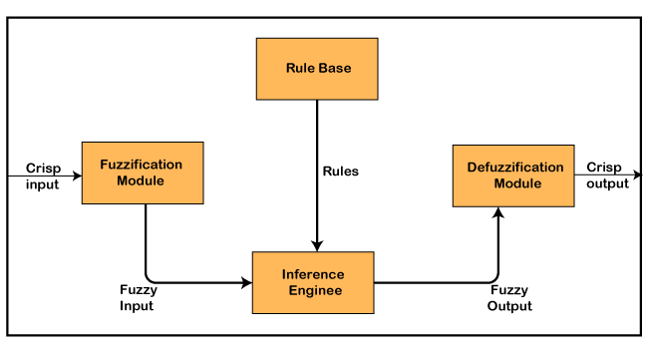
Structure of Mamdani Fuzzy control System

Slide 39
Fuzzy logic applications
1> In automobiles, fuzzy logic is used for gear selection and is based on factors such as engine load, road conditions and style of driving.
2> In dishwashers, fuzzy logic is used to determine the washing strategy and power needed, which is based on factors such as the number of dishes and the level of food residue on the dishes.
3> In copy machines, fuzzy logic is used to adjust drum voltage based on factors such as humidity, picture density and temperature.
4> In aerospace, fuzzy logic is used to manage altitude control for satellites and spacecrafts based on environmental factors.
5> In medicine, fuzzy logic is used for computer-aided diagnoses, based on factors such as symptoms and medical history.

Slide 40
Architecture of Mamdani type Fuzzy Controller
Fuzzy Controller for Washing Machine

Slide 41
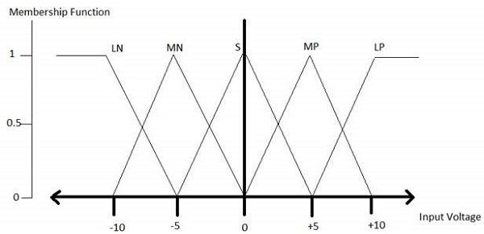
Membership Function
A membership function for a fuzzy set A on the universe of discourse X is defined as μA:X → [0,1].
x axis represents the universe of discourse.
y axis represents the degrees of membership in the [0, 1] interval.

Slide 42
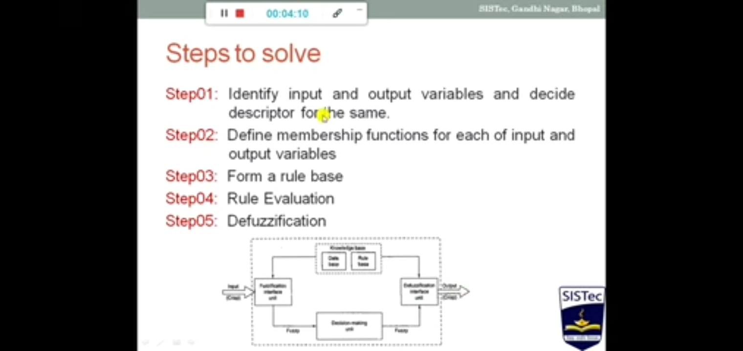

Slide 43
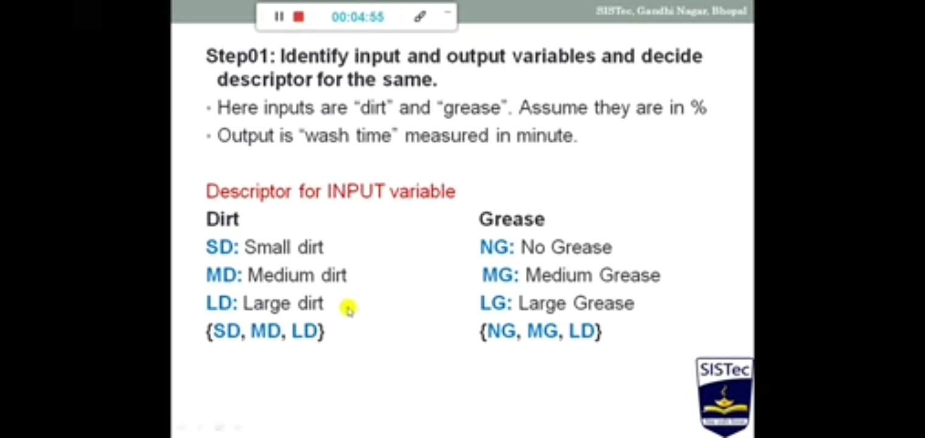

Slide 44
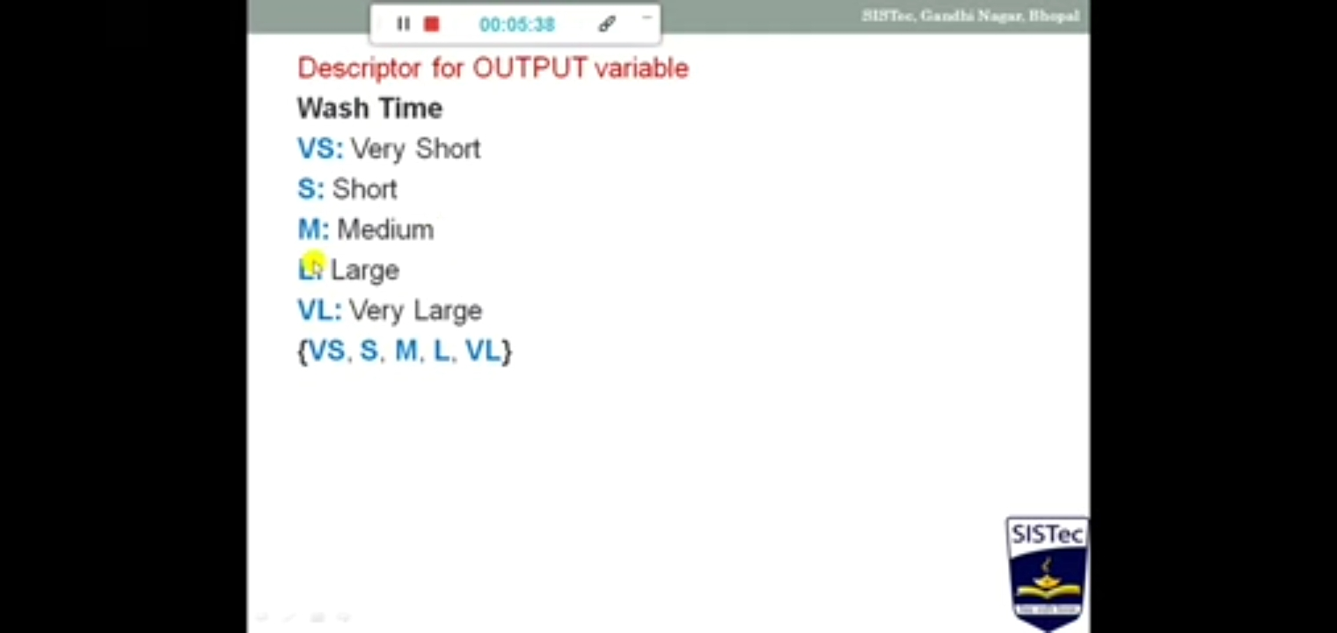

Slide 45
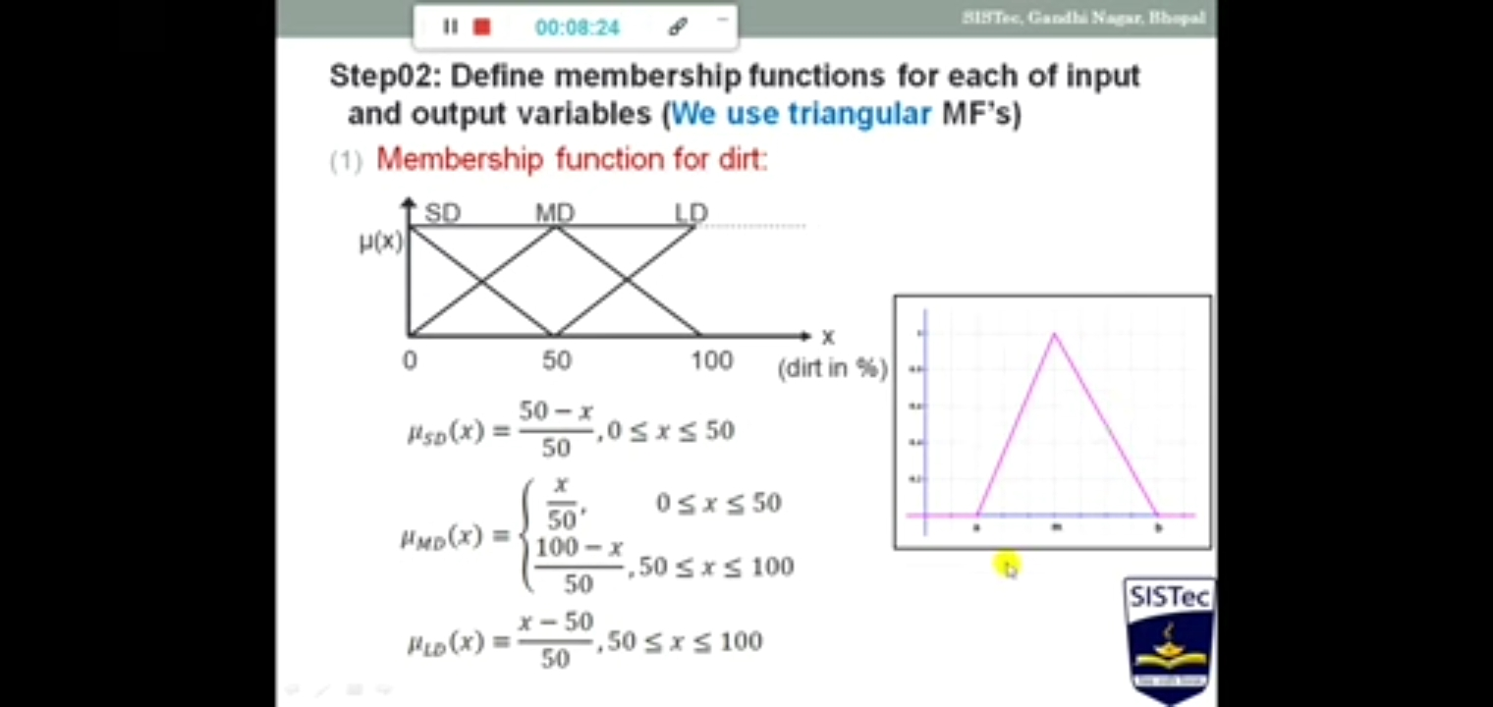

Slide 46
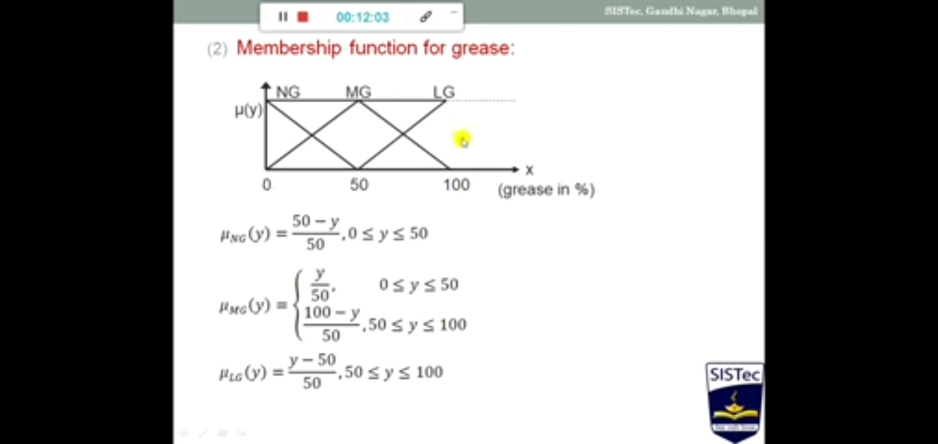

Slide 47
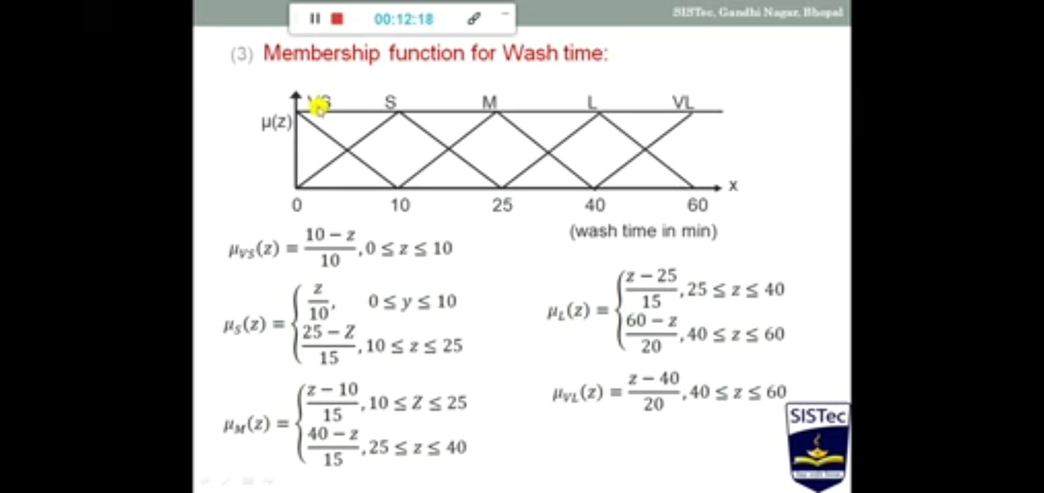

Slide 48
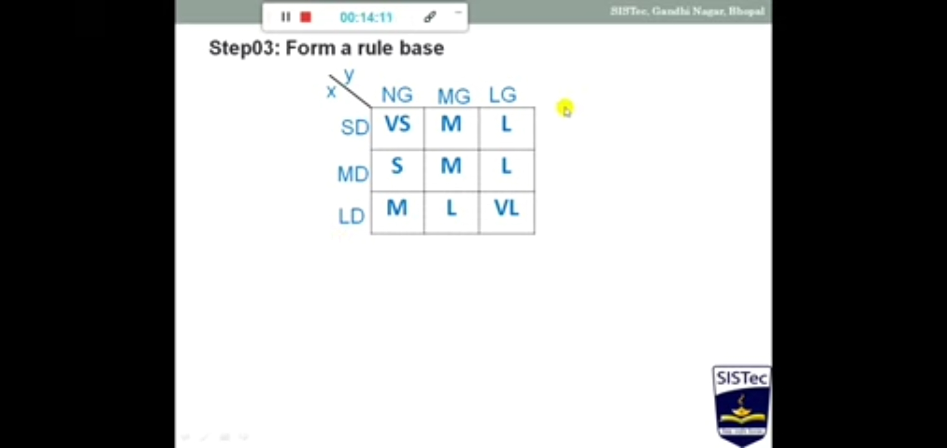

Slide 49
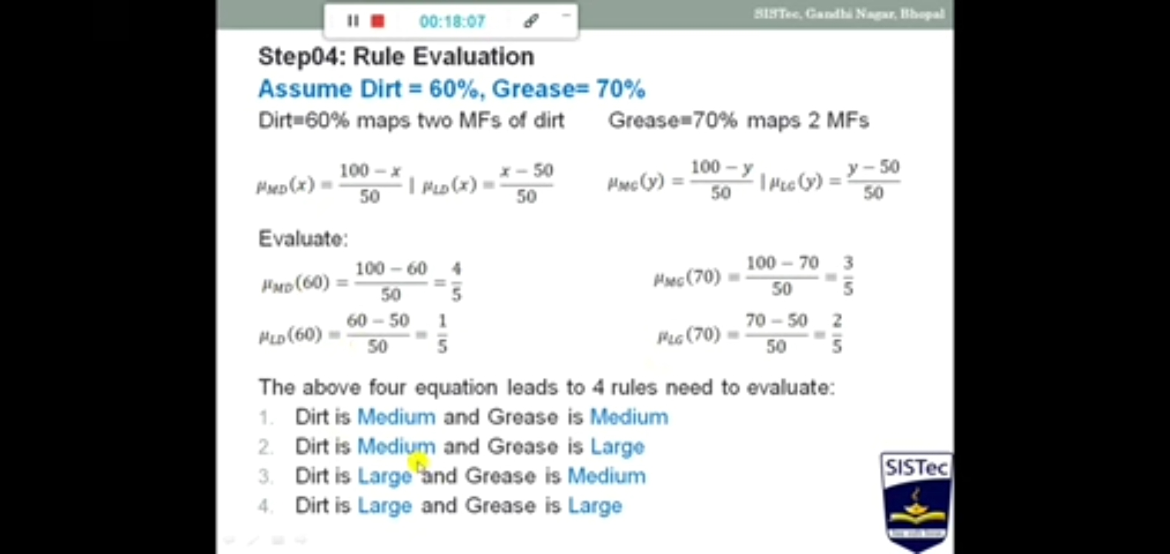

Slide 50
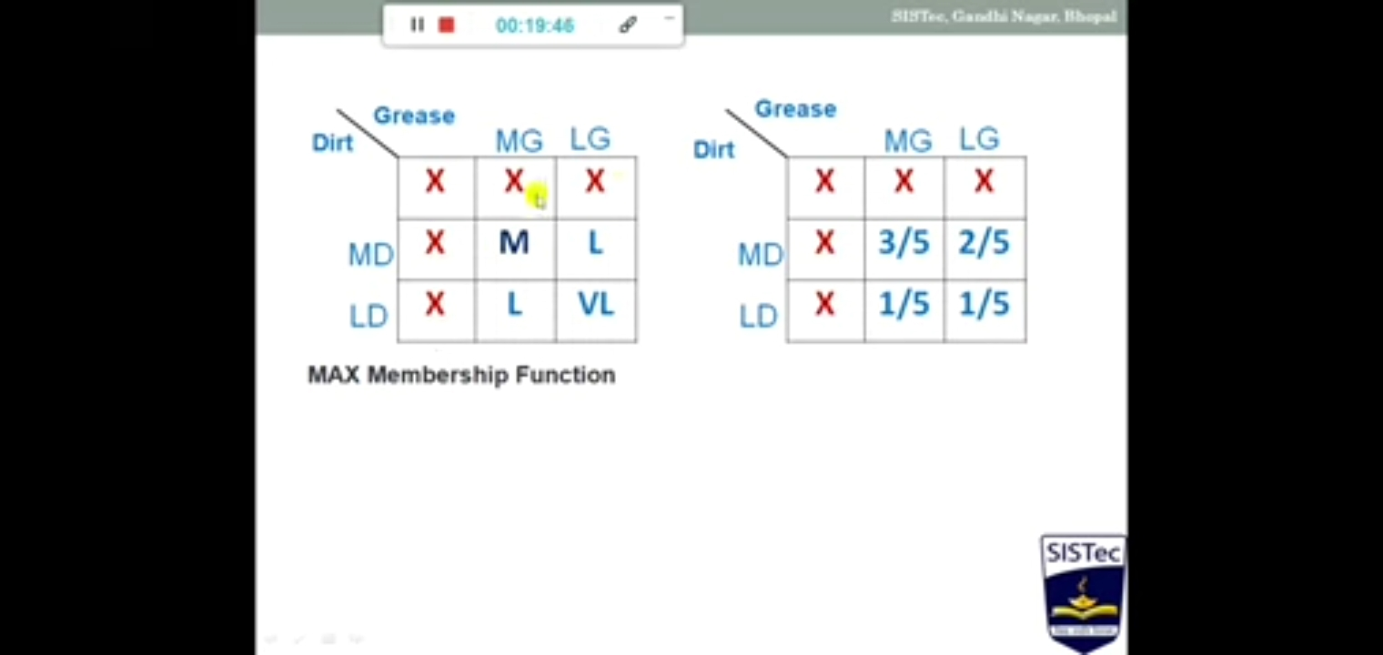

Slide 51
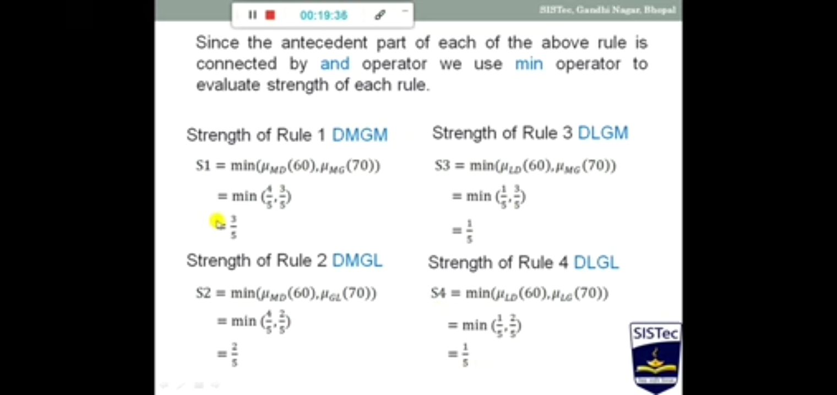

Slide 52
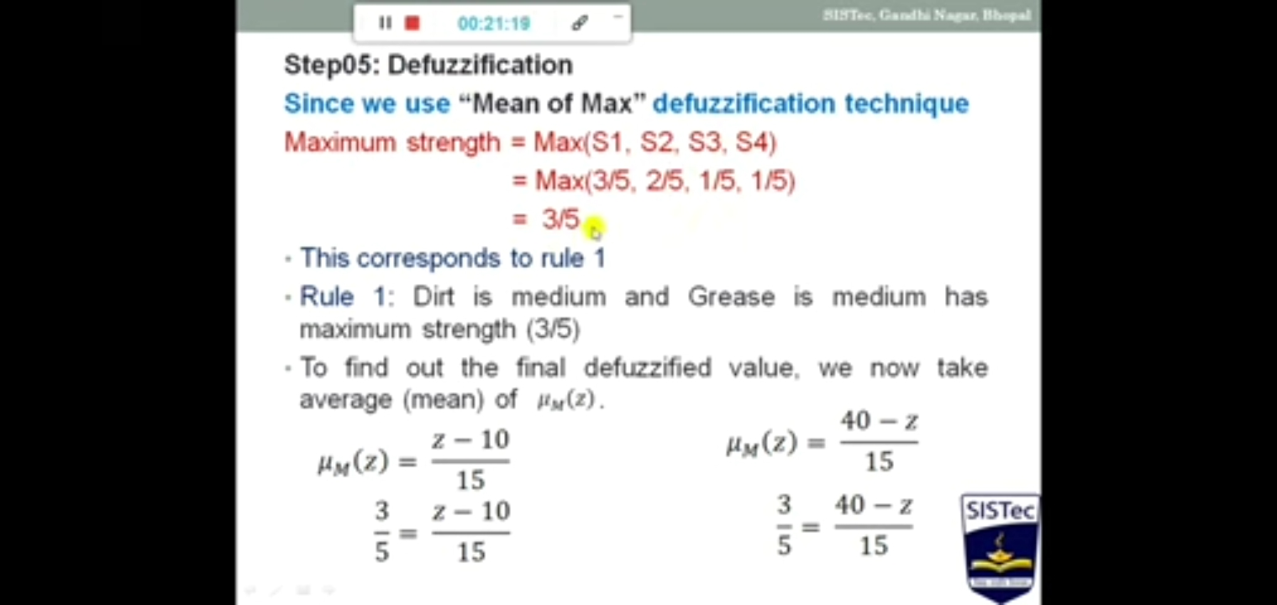

Slide 53
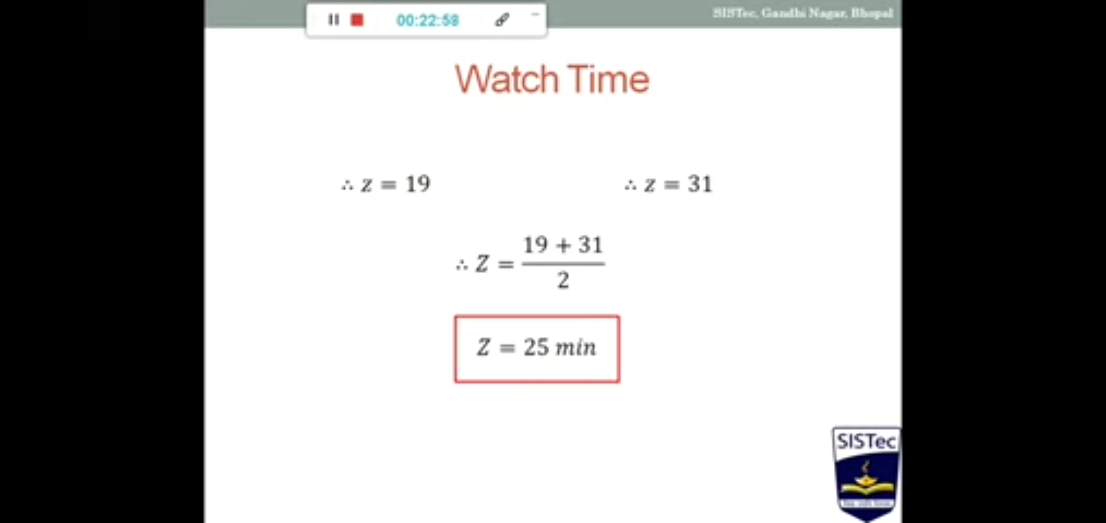

Slide 54
Module 4
Deep Learning

Slide 55
LSTM
> A long short-term memory network is a type of recurrent neural network (RNN).
> LSTMs are predominantly used to learn, process, and classify sequential data because these networks can learn long-term dependencies between time steps of data.
>applications include sentiment analysis, language modeling, speech recognition, and video analysis.

